Slide 1
Image Encryption
FEAL cipher encryption of grayscale images
By Didier lessage and robert veira

Slide 2
Introduction
The types of messages sent today move beyond simple text
Users value security and confidentiality when sharing information online:
Facebook
Instagram
Twitter
Notes:
At the beginning of encryption, users simply had to worry about encrypting textual messages. However, with present times, users are sharing much more than simple text messages and text based emails. Photos are being shared through email attachments and social media sites such as Facebook, Instagram, and Twitter. Users want a way to ensure the images they share solely are viewed by their loved ones, limiting the amount of exposure these images may receive from strangers.

Slide 3
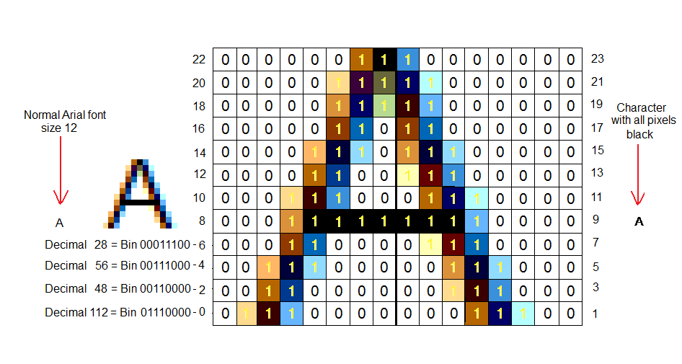
Encrypting an image
Notes:
Images, at their core, are simply an arrangement of bytes. If we simplify the image to pure black and white, each byte only needs to tell the displaying software whether black is displayed in a certain section of the image or not. If color is introduced in the image, each pixel contains an RGB value, which can be easily represented on a byte by byte basis. It is this information that is encrypted when the image itself is run through some encryption protocol.

Slide 4
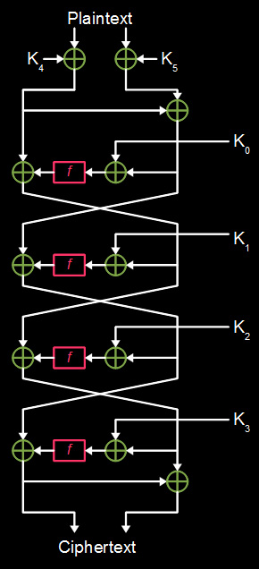
FEAL algorithm encryption
FEAL
Fast Encryption Algorithm (FEAL)
Similar to the Data Encryption Standard (DES) algorithm
Faster than the DES algorithm
Image split into 16x16 blocks
Image decrypted/encrypted using a number of keys of 16-bit length
Pictured to the left is an image representation of a FEAL key being generated
N. Nithin, A. Bongale, G.P. Hegde Image Encryption based on FEAL algorithm. In the International Journal of Advances in Computer Science and Technology, Volume 2, No. 3 (March 2013)
Notes:
The Fast Encryption Algorithm (FEAL) through text is done through both splitting the text into two halves and running a decryption on the text through multiple iterations and swaps. With an image, the FEAL algorithm is handled by dividing a 256x256 grayscale image into 16x16 image. 12 keys are also generated, half of which will be used to encrypt the image. The other 6 keys are used to decrypt the image.

Slide 5
Project Goals
Attempt to emulate the FEAL encryption method used in Nithin, Bongale, and Hegde paper
Compare our results to the results of the emulated work
Encrypted/Decrypted image output
Incorrect key decryption output
Histogram of pre-encrypted and encrypted image
Report on both the benefits and shortcomings of the FEAL encryption method
FEAL cipher image encryption
Notes:
What we propose to do is implement the FEAL encryption method for image encryption used in the 2013 Nithin, Bongale, and Hegde paper. When the results we obtain are compared to the results reported in the paper, we will determine if we are able to get similar results in the encrypted/decrypted image output, the output of the image when an incorrect key is used, as well as the histogram of both the pre-encrypted and encrypted image’s pixel values in grayscale.

